Slide 1
Status Report: Art Generation using GANs
Ali Karpuzoglu
Felix Friedrich
Pengfei Zhao

Slide 2
Overview
Recent progress
Data collection
Finding the correct architecture
Lessons learned

Slide 3
Progress - Data Collection
Celeba Dataset
Initially used to test our architecture
200k images of faces
Web Scraping
Gathered artworks by wikiart.org
At most 3600 Images scrapeable
Abstract, landscapes, cityscapes

Slide 4
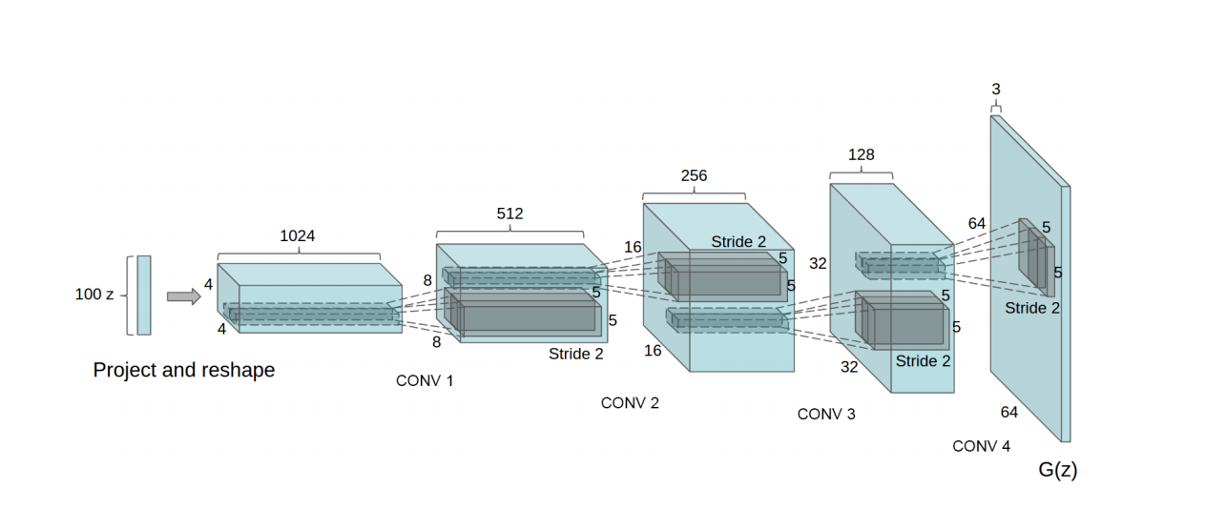
Progress - Correct architecture
arXiv:1511.06434 [cs.LG]
Notes:
https://arxiv.org/abs/1511.06434
The original architecture. We tried to go with a similar architecture, and added one layer for a higher resolution, but our generator only produced gray images, so we had to change it around

Slide 5
Important Tricks
Normalize images between -1, 1
Use Batch Normalization
Replace Fully Connected Layers with Convolutional Layers

Slide 6
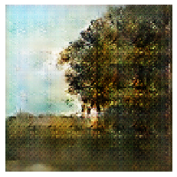
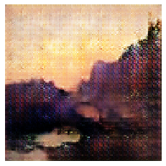
Results

Slide 7
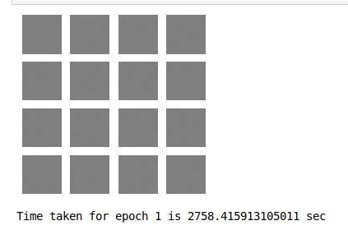
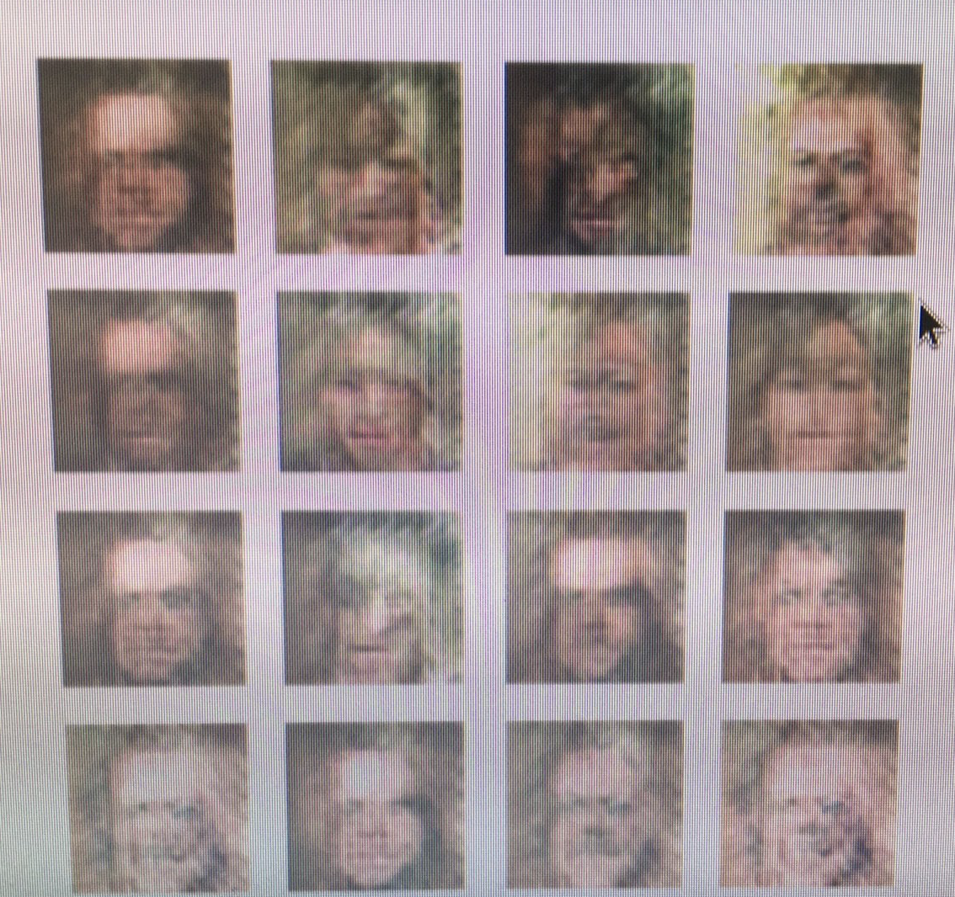
Lessons learned
Sanity checks
Verify input
Notes:
Sanity check: We looked at the states before we trained on a whole epoch. This was to verify our architecture, since we had a few runs where the generator did not produce anything usable
Verify input: when normalizing and augmenting, we expected the output to be in the range of [-1,1] but we trained the net on input that was [0,1]. When undoing the normalization, the images were brighter than expected.

Slide 8
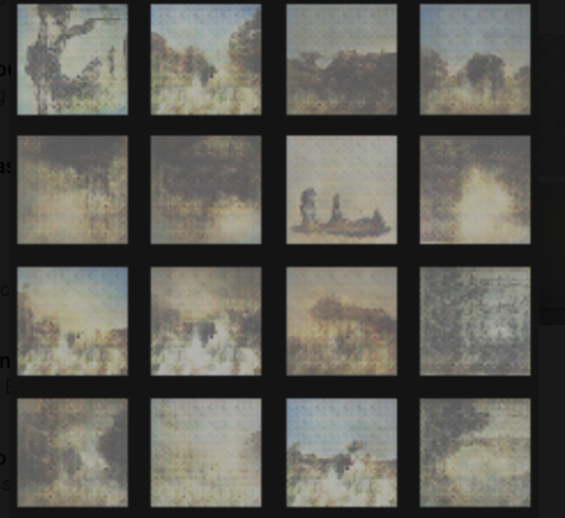
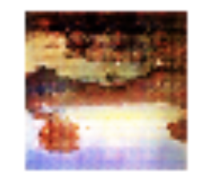
Lessons learned
Don't flip landscape images upside down for training
Verify input(!)
Notes:
Sanity check: We looked at the states before we trained on a whole epoch. This was to verify our architecture, since we had a few runs where the generator did not produce anything usable
Verify input: when normalizing and augmenting, we expected the output to be in the range of [-1,1] but we trained the net on input that was [0,1]. When undoing the normalization, the images were brighter than expected.

Slide 9
Next Steps

Slide 10
Next steps
Train for a bit longer
Publish weights
Publish some images
Try out even higher resolutions
It turned out to be very hard to train the GANs for large images

Slide 11
Thank you
Source:
Unsupervised Representation Learning with Deep Convolutional Generative Adversarial Networks (arXiv:1511.06434 )
https://github.com/robbiebarrat/art-DCGAN

